Slide 1

Module 07
Navigating the Filesystem

Slide 2
Exam Objective
2.3 Using Directories and Listing Files
Objective Description
Navigation of home and system directories and listing files in various locations.
Notes:
Navigation of home and system directories and listing files in various locations.

Slide 3
Introduction

Slide 4

Introduction
In Linux, everything is stored in files.
Files are used to store data such as text, graphics, and programs.
Directories are a type of file used to store other files.
Directories are used to provide a hierarchical organization structure.

Slide 5
Directory Structure

Slide 6
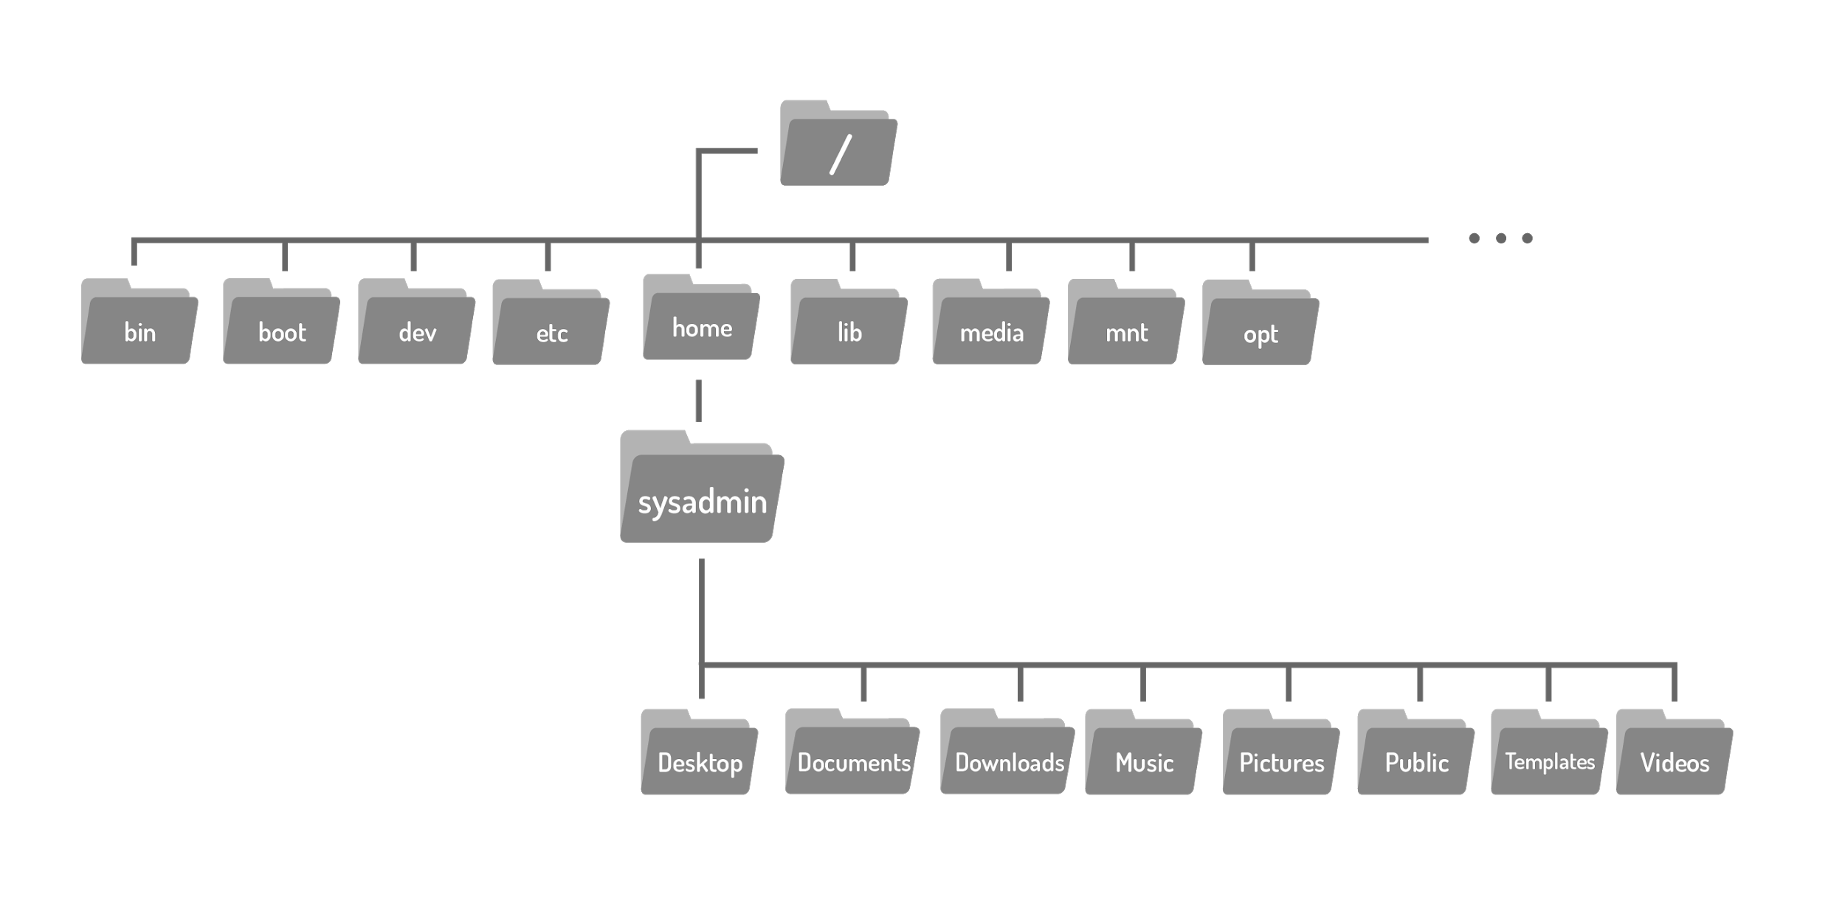
Directory Structure
On a Windows system, the top level of the directory structure is called My Computer.
The Linux directory structure, called a filesystem, also has a top level called the root directory (symbolized by the slash / character).

Slide 7
Directory Structure
To view the contents of the root directory, use the ls command with the / character as the argument:
Notice that there are many directories with descriptive names including /boot, which contains files to boot the computer.
sysadmin@localhost:~$ ls /
bin dev home lib media opt root sbin selinux sys usr
boot etc init lib64 mnt proc run sbin??? srv tmp var

Slide 8
Home Directory
On most Linux distributions there is a directory called home under the root / directory.
Under this /home directory there is a directory for each user on the system.
When a user opens a shell, they should automatically be placed in their home directory.
The user has the full control to create and delete additional files and directories in their home directory.
Most other directories in a Linux filesystem are protected with file permissions.
The home directory has a special symbol used to represent it, the tilde ~ character.

Slide 9
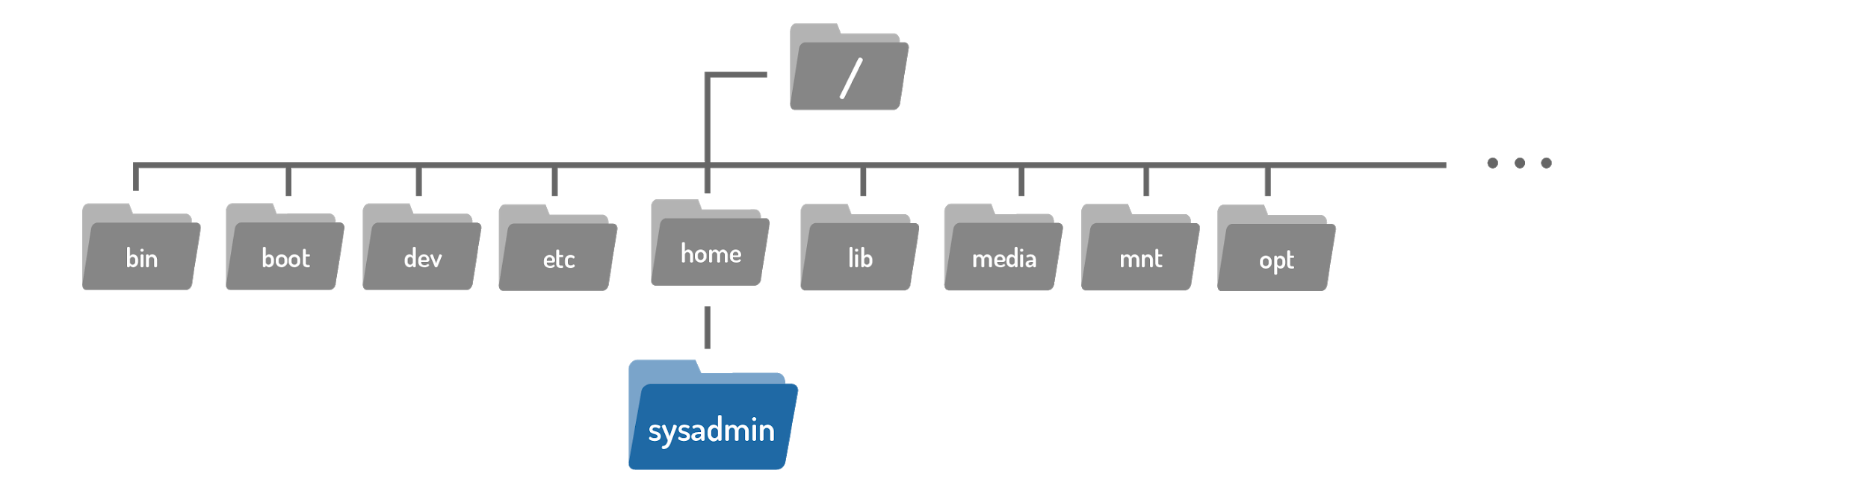
Home Directory
The directory name is the same as the name of the user.
So, a user named sysadmin would have a home directory called /home/sysadmin:

Slide 10
Current Directory
The pwd (print working directory) command can be used to determine where the user is currently located within the filesystem.
The pwd command prints the working directory, which is the current location of the user within the filesystem.
pwd [OPTIONS]
sysadmin@localhost:~$ pwd
/home/sysadmin

Slide 11
Changing Directories
When a user opens a shell, they typically begin in their home directory.
To navigate the filesystem, use the cd (change directory) command.
To move from the home directory into the Documents directory use the directory name as an argument to the cd command:
After changing directories, the new location can also be confirmed in the new prompt, again shown in blue.
cd [options] [path]
sysadmin@localhost:~$ cd Documents sysadmin@localhost:~/Documents$

Slide 12
Changing Directories
When used with no arguments, the cd command will take the user to their home directory.
If the user tries to change to a directory that does not exist, the command returns an error message:
sysadmin@localhost:~/Documents$ cd sysadmin@localhost:~$
sysadmin@localhost:~$ cd Junk -bash: cd: Junk: No such file or directory

Slide 13
Paths

Slide 14
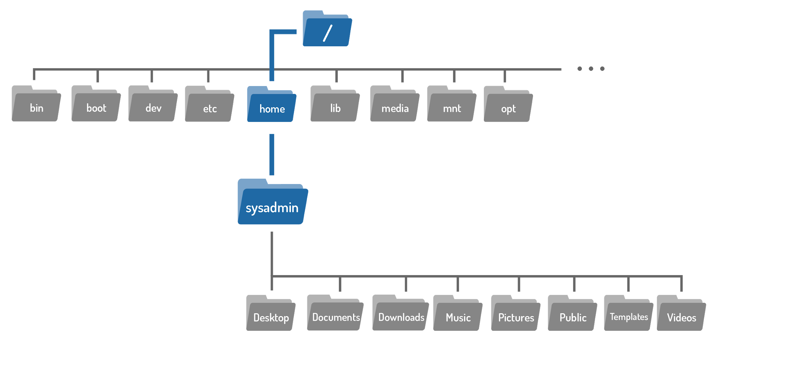
Paths
A path is a list of directories separated by the / character.
There are two types of paths: absolute and relative.
For example, /home/sysadmin is a path to the home directory:

Slide 15
Absolute Paths
Absolute paths allow the user to specify the exact location of a directory.
Absolute paths always starts at the root directory, and therefore it always begins with the / character.
The path /home/sysadmin is an absolute path; it tells the system to:
Begin at the root / directory > move into the home directory > then into the sysadmin directory
If the path /home/sysadmin is used as an argument to the cd command, it moves the user into the home directory for the sysadmin user.
sysadmin@localhost:~/Documents$ cd /home/sysadmin sysadmin@localhost:~$

Slide 16
Relative Paths
A relative path gives directions to a file relative to the current location in the filesystem.
The user must currently be in a directory that contains objects in the path
Relative paths start with the name of a directory:
sysadmin@localhost:~/Documents/$ cd School/Art sysadmin@localhost:~/Documents/School/Art$

Slide 17
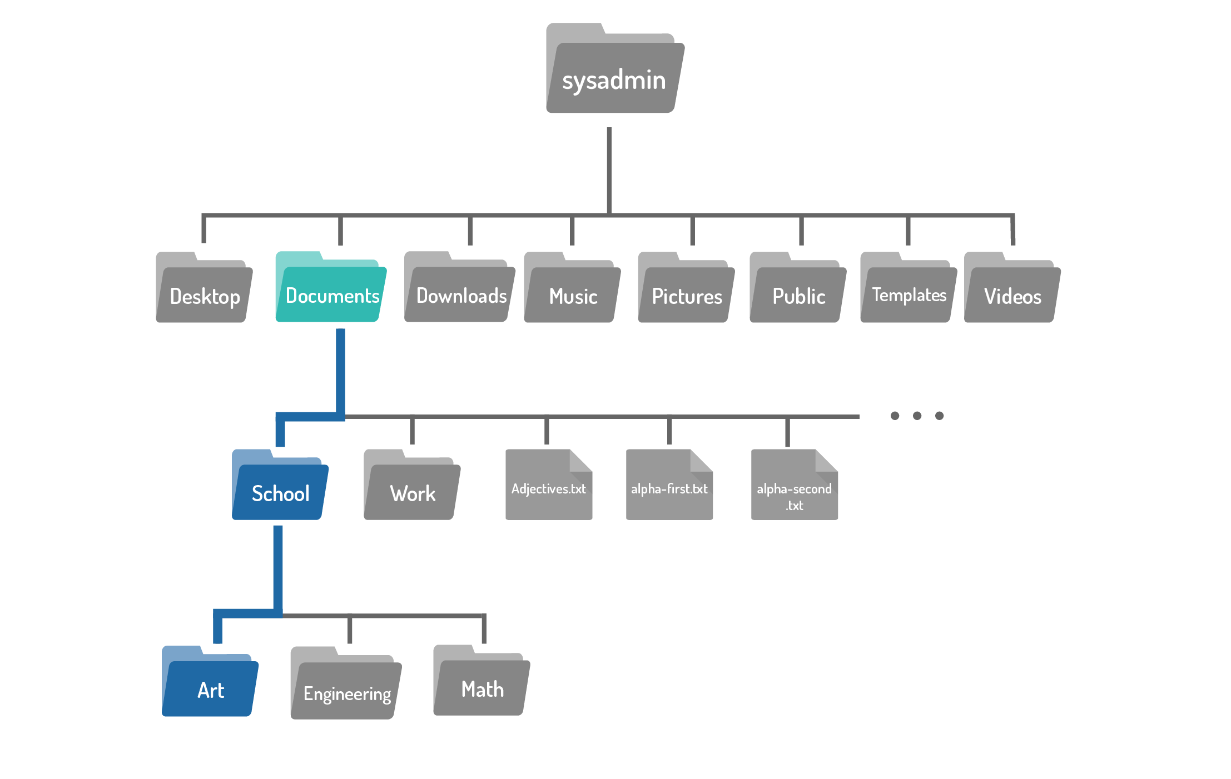
Relative Paths

Slide 18
Paths - Shortcuts: The .. Characters
Two period .. characters always represents one directory higher relative to the current directory, sometimes referred to as the parent directory.
For example, to move from the Art directory back to the School directory:
The double dot can also be used in longer paths as well:
sysadmin@localhost:~/Documents/School/Art$ cd .. sysadmin@localhost:~/Documents/School$
sysadmin@localhost:~/Documents/School$ cd ../../Downloads

Slide 19
Paths - Shortcuts: The . Character
The single period . character always represents the current directory.
For the cd this shortcut is not very useful, but it comes in handy for commands covered in subsequent sections.

Slide 20
Listing Files in a Directory

Slide 21
Listing Files in a Directory
The ls (list) command is one of the most powerful tools for navigating the filesystem.
The ls command is used to display the contents of a directory and can provide detailed information about the files.
When used with no options or arguments, the ls command lists the files in the current directory:
The ls command can also be used to list the contents of any directory in the filesystem, provide the path to the directory as an argument.
ls [OPTION]... [FILE]...
sysadmin@localhost:~$ ls
Desktop Documents Downloads Music Pictures Public Templates
Videos

Slide 22
Listing Hidden Files
A hidden file is any file (or directory) that begins with a dot . character.
The ls command omits hidden files by default.
To display all files, including hidden files, use the -a option to the ls command:
Most of the hidden files are customization files, designed to customize how Linux, your shell or programs work.
For example, the .bashrc file in the home directory customizes features of the shell
sysadmin@localhost:~$ ls -a
. .bashrc .selected_editor Downloads Public
.. .cache Desktop Music Templates
.bash_logout .profile Documents Pictures Videos

Slide 23
Long Display Listing
Each file has details associated with it called metadata, this can include information such as the size, ownership, or timestamps.
Use the -l option to the ls command to view this information.
For example, below, a listing of the /var/log directory:
In the output above, each line describes metadata about a single file.
sysadmin@localhost:~$ ls -l /var/log/
total 832
-rw-r--r-- 1 root root 17869 Mar 14 17:48 alternatives.log
drwxr-x--- 2 root adm 4096 Mar 14 17:48 apache2
drwxr-xr-x 2 root root 4096 Mar 14 17:45 apt
-rw-r----- 1 syslog adm 380 Jul 28 03:45 auth.log

Slide 24
Long Display Listing
The following describes each of the fields of data in the output of the ls -l command:
File Type:
The first character of each line indicates the type of file. The file types are:
Symbol File Type Description
d directory A file used to store other files.
- regular file Includes readable files, images files, binary files, and compressed files.
l symbolic link Points to another file.
s socket Allows for communication between processes.
p pipe Allows for communication between processes.
b block file Used to communicate with hardware.
c character file Used to communicate with hardware.
-rw-r--r-- 1 root root 17869 Mar 14 17:48 alternatives.log
drwxr-x--- 2 root adm 4096 Mar 14 17:48 apache2

Slide 25
Long Display Listing
Permissions:
The next nine characters demonstrate the permissions of the file.
Permissions indicate how certain users can access a file.
Hard Link Count:
This number indicates how many hard links point to this file.
drwxr-xr-x 1 root root 0 Apr 11 21:58 upstart
-rw-r----- 1 syslog adm 23621 Aug 23 15:17 auth.log

Slide 26
Long Display Listing
User Owner:
Every file is owned by a user account.
This is important because the owner has the rights to set permissions on a file.
Group Owner:
Indicates which group owns this file, this is important because any member of this group has a set of permissions on the file.
-rw-r----- 1 syslog adm 416 Aug 22 15:43 kern.log
-rw-rw-r-- 1 root utmp 292584 Aug 20 18:44 lastlog

Slide 27
Long Display Listing
File Size:
Size of files in bytes.
Timestamp:
Indicates when a file’s contents were last modified.
File Name:
The name of the file or directory.
-rw-r----- 1 syslog adm 1087150 Aug 23 15:17 syslog.1
drwxr-xr-x 1 root root 32 Jul 17 03:36 fsck
-rw-r--r-- 1 root root 47816 Jul 17 03:36 bootstrap.log

Slide 28
Human Readable Sizes
The -l option to the ls command displays file sizes in bytes.
For text files, a byte is 1 character so small files are easy to read, but for larger files, it is hard to comprehend how large the file is:
The file size is hard to determine in bytes. Is 1561400 a large file or small?
To present the file size in a more human readable size, like megabytes or gigabytes, add the -h option (with the -l option) to the ls command:
sysadmin@localhost:~$ ls -l /usr/bin/omshell
-rwxr-xr-c 1 root root 1561400 Oct 9 2012 /usr/bin/omshell
sysadmin@localhost:~$ ls -lh /usr/bin/omshell
-rwxr-xr-c 1 root root 1.5M Oct 9 2012 /usr/bin/omshell

Slide 29
Listing Directories
When the command ls -d is used, it refers to the current directory, and not the contents within it.
The . represents the current directory.
The ls -l command lists the contents of the directory:
sysadmin@localhost:~$ ls -d
.
sysadmin@localhost:~$ ls -l
total 0
drwxr-xr-x 1 sysadmin sysadmin 0 Apr 15 2015 Desktop
drwxr-xr-x 1 sysadmin sysadmin 0 Apr 15 2015 Documents
drwxr-xr-x 1 sysadmin sysadmin 0 Apr 15 2015 Downloads

Slide 30
Listing Directories
To use the ls -d command in a meaningful way requires the addition of the -l option:
sysadmin@localhost:~$ ls -ld
drwxr-xr-x 1 sysadmin sysadmin 224 Nov 7 17:07 .

Slide 31
Recursive Listing
Recursive listing is when you want to display all of the files in a directory as well as all of the files in all subdirectories under a directory.
To perform a recursive listing, use the -R option to the ls command:
Note that in the example above, the files in the /etc/ppp directory were listed first and the files in the /etc/ppp/peers directory were listed after.
sysadmin@localhost:~$ ls -R /etc/ppp
/etc/ppp:
chap-secrets ip-down.ipv6to4 ip-up.ipv6to4 ipv6-up pap-secrets
ip-down ip-up ipv6-down options peers
/etc/ppp/peers:
Output Omitted...
Be careful with this option; for example, running the command on the root directory would list every file on the file system.

Slide 32
Sort a Listing
By default, the -ls command sorts files alphabetically by file name.
Sometimes it may be useful to sort files using different criteria.
To sort files by size, we can use the -S option (capital letter s).
While the -S option works by itself, it is most useful when used with the -l option so the file sizes are visible:
sysadmin@localhost:~$ ls -lS /etc/ssh
total 160
-rw-r--r-- 1 root root 125749 Apr 29 2014 moduli
-rw-r--r-- 1 root root 2489 Jan 29 2015 sshd_config
-rw------- 1 root root 1675 Jan 29 2015 ssh_host_rsa_key

Slide 33
Sort a Listing
It may also be useful to use the -h option to display human-readable file sizes:
The -t option sorts files based on the time they were modified:
sysadmin@localhost:~$ ls -lSh /etc/ssh
total 160K
-rw-r--r-- 1 root root 123K Apr 29 2014 moduli
-rw-r--r-- 1 root root 2.5K Jan 29 2015 sshd_config
-rw------- 1 root root 1.7K Jan 29 2015 ssh_host_rsa_key
Output Omitted...
sysadmin@localhost:~$ ls -tl /etc/ssh
total 160
-rw------- 1 root root 668 Jan 29 2015 ssh_host_dsa_key
-rw-r--r-- 1 root root 607 Jan 29 2015 ssh_host_dsa_key.pub
-rw------- 1 root root 227 Jan 29 2015 ssh_host_ecdsa_key
Output Omitted...

Slide 34
Sort a Listing
For more detailed modification time information you can use the --full-time option to display the complete timestamp (including hours, minutes, seconds):
It is possible to perform a reverse sort by using the -r option. It can be used alone, or combined with either the -S or -t options:
sysadmin@localhost:~$ ls -t --full-time /etc/ssh
total 160
-rw------- 1 root root 668 2015-01-29 03:17:33.000000000 +0000 ssh_host_dsa_key
-rw-r--r-- 1 root root 607 2015-01-29 03:17:33.000000000 +0000 ssh_host_dsa_key.pub
-rw------- 1 root root 227 2015-01-29 03:17:33.000000000 +0000 ssh_host_ecdsa_key
sysadmin@localhost:~$ ls -lrS /etc/ssh
total 160
-rw-r--r-- 1 root root 179 Jan 29 2015 ssh_host_ecdsa_key.pub
-rw------- 1 root root 227 Jan 29 2015 ssh_host_ecdsa_key

